Slide 1
Introduction to Administering Office 365
Notes:
Questions:
Who resells IT services?
Who is representing their own org for this tech?
Some facts:
Office 365 is in use at 4 out of 5 fortune 500 companies
There are over 60 movbile apps for office now availbile on on all platforms
365 is Microsoft’s fastest growing business
Henry

Slide 2
Course Objectives
Cover Skills necessary for IT professionals to succeed with 365 administration
Learn about Office 365 platform, service and offerings
Execute common small business management tasks within Office 365
Learn about Exchange Online security, SPAM, archiving, compliance and more
Learn service and site management for SharePoint Online; Lync Online, OneDrive and Yammer
Use PowerShell to connect to & manage Office 365 for common tasks
Notes:
Henry
On MVA , you can get this and coruses like it which cover: list stuff

Slide 3
Assumed Knowledge
Windows PowerShell™
Network Technologies
AD sites, trusts, & topology
DNS & related technologies
Wide area connectivity: networks, equipment, bandwidth & latency
Firewall technologies
SSL certificates
Server Technologies
Active Directory
Exchange Server
Office Communications Server, Lync Server
SharePoint Server
Active Directory Federation Services (AD FS)
Client Technologies
Microsoft Office
Mobility
Recommended Reading: Working with Microsoft Office 365: Running your Business in the Cloud
https://www.microsoft.com/learning/en-us/Book.aspx?ID=15184
Notes:
Henry – Don’t be 100% new, you should know about Office, Windows Servers, Sharepoint and eXchange.

Slide 4

Join the MVA Community!
Microsoft Virtual Academy
Free online learning tailored for IT Pros and Developers
Over 2M registered users
Up-to-date, relevant training on variety of Microsoft products
Notes:
Henry

Slide 5
Agenda
Administering Office 365 | Administering Office 365
Office 365 Overview & Infrastructure | Exchange Online Deployment & Migration
Office 365 User Management | Exchange Security, Archiving, & Compliance
Office 365 DirSync, Single Sign-On, & Same Sign-On | Administering OneDrive for Business
Administering Lync Online for SMB | Administering Yammer for SMB
Administering SharePoint Online for SMB | Troubleshooting and Support for SMB
Administering Exchange Online for SMB
SMB = Small and Medium Businesses
Notes:
Henry

Slide 6


Thomas Rayner, MVP​
Systems Admin, NAIT Instructor​
President Edmonton Microsoft User Group – emug.ca – Sign up for our mailing list​
Blog: workingsysadmin.com​
Twitter: @MrThomasRayner LinkedIn: linkedin.com/in/thomasrayner​
​
Henry Bosch​
Team Manager
VP Edmonton Microsoft User Group - emug.ca
Twitter: @boschkobi LinkedIn: linkedin.com/in/hbosch​
Notes:
Both

Slide 7


Module 1: Office 365 Overview & Infrastructure
Service Overview & Offering
Features & Requirements
Office 365 Administration | Portals & PowerShell
Partner Opportunity
Notes:
Thomas 1/3
Henry 2/4 features & partner

Slide 8
Module 1: Office 365 Overview & Infrastructure
Service Overview & Offering

Slide 9

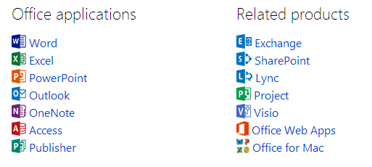




Office 365 Overview
Get virtually anywhere access to the Microsoft Office tools you know and rely on, plus easy to administer business-class IT services
OneDrive
Yammer
Video
Delve
Notes:
Slide Objectives:
Announcing Office 365. Explaining what‘s about.
Sway, extras...

Slide 10
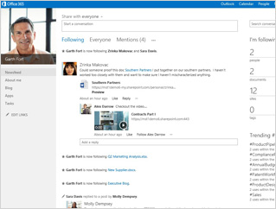
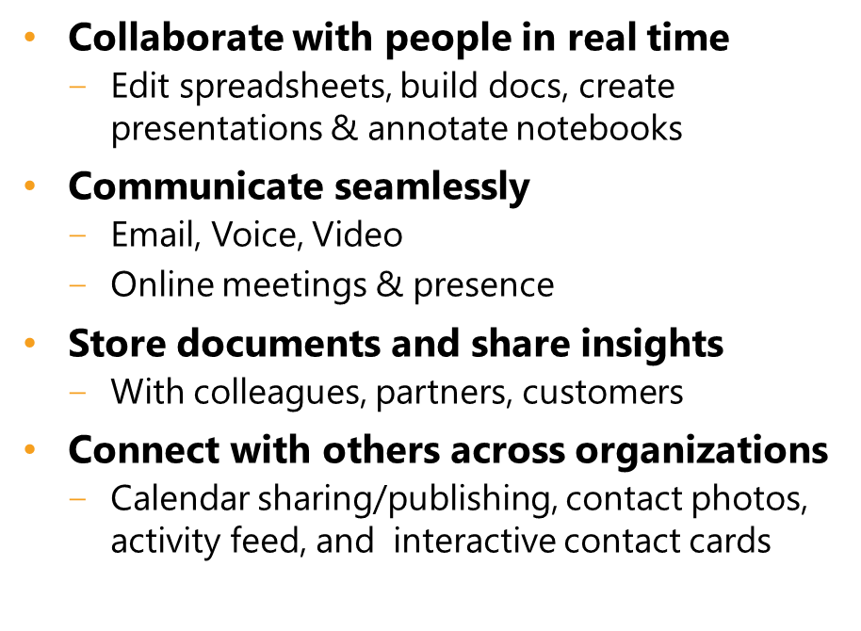
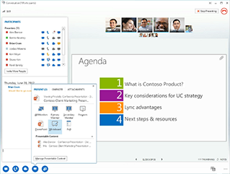
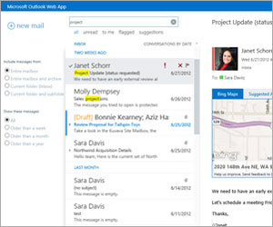
Anywhere Access

Slide 11
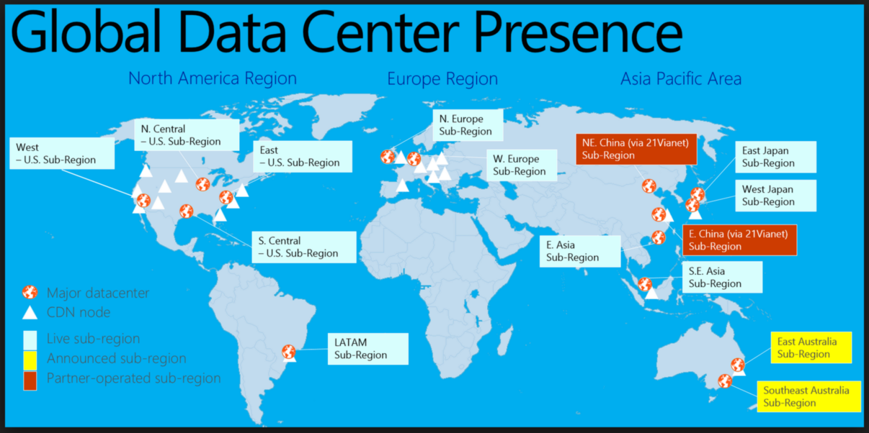
Worldwide, Secure, Compliant Datacenters
Notes:
Slide Objectives:
You should use this slide to show Microsoft Datacentres locations around the world.
It won’t break…..
North America is the hotspot here, geographically spread
Canada on line soon for Azure, summer for 365
DR: You can replicate you stuff… This is good..

Slide 12
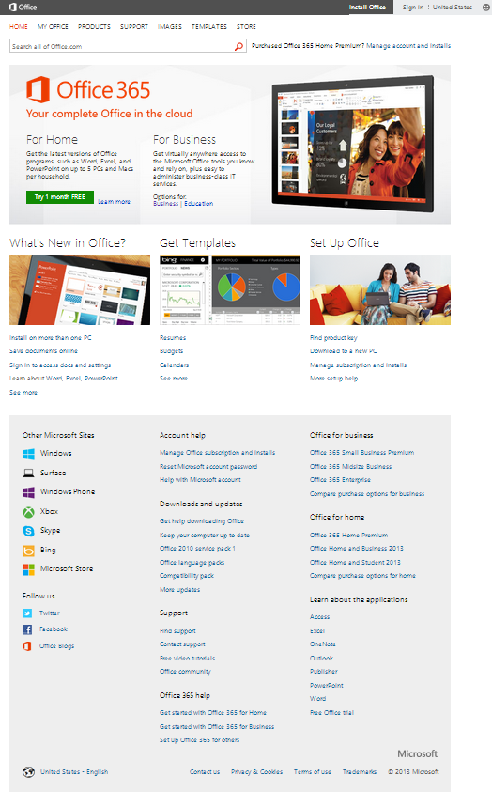
Dive Into Office 365
Stay up-to-date on the latest information and buzz
Explore the new features
Experience seamless integration across services and devices
Please sign up here: http://www.office365.com

Slide 13
Office 365 Platform Capabilities
Simple user interface
Simplified licensing
Role-based access control
Identity federation (eliminate sign-in client)
Multi-factor authentication support
Remove scale limitation

Slide 14
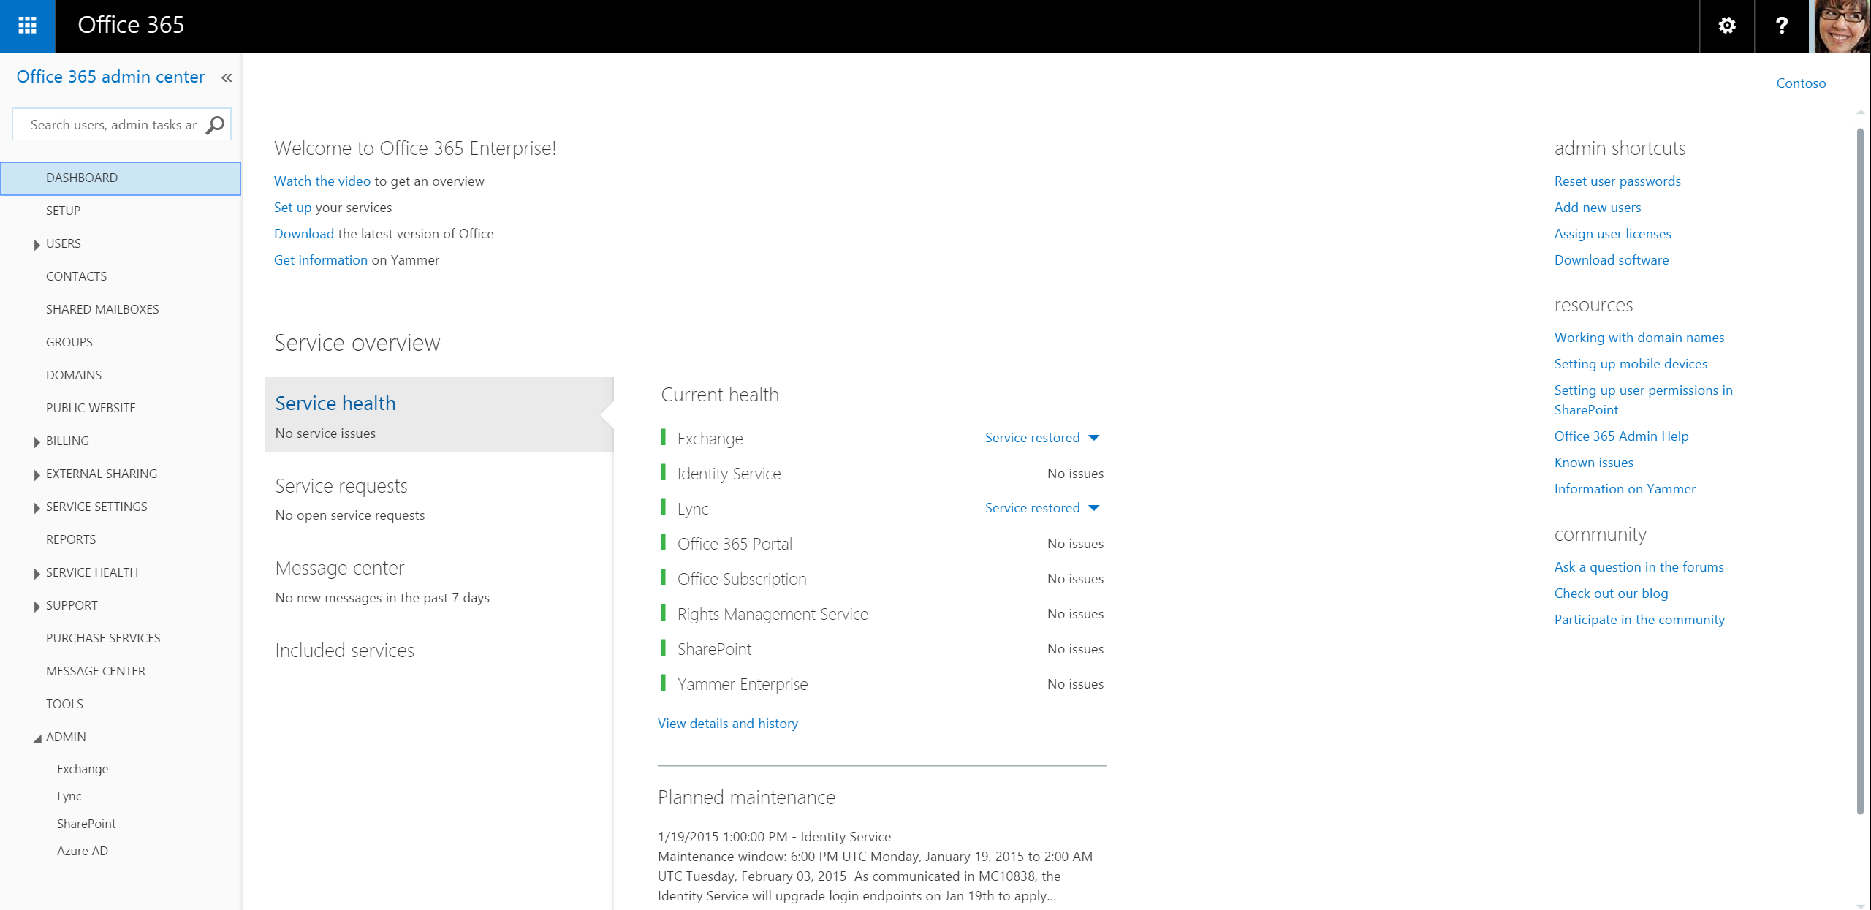
Simplified Interfaces and Portals

Slide 15
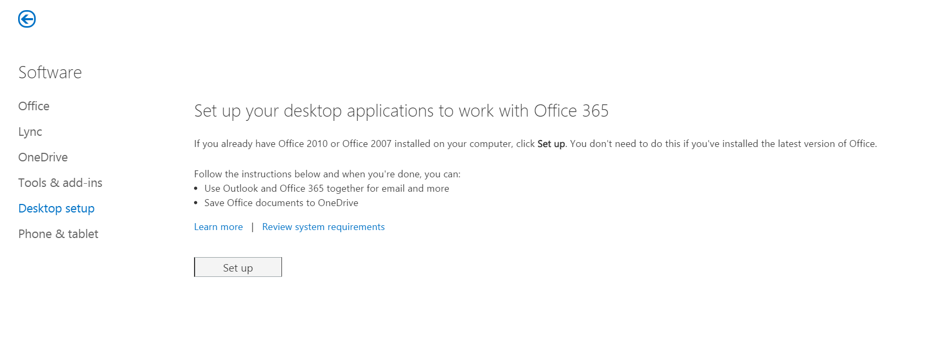
Services Connector
Helps prepare workstations to run with Office 365
Only need to run once
One-off patching & configuration of clients leveraging Microsoft Update
Manual configuration possible

Slide 16
Module 1: Office 365 Overview & Infrastructure
Service Overview & Offering
Features & Requirements
Office 365 Administration | Portals & PowerShell
Partner Opportunity

Slide 17
Module 1: Office 365 Overview & Infrastructure
Features & Requirements
Notes:
Henry

Slide 18


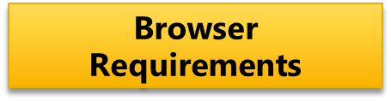
Platform Requirements
Office 365 does not have an operating system requirement, except that the Windows or Macintosh OS software you use must be supported by Microsoft or Apple. There may, however, be advanced Office 365 configuration options, features, scenarios, and/or tools that have explicit dependencies on an operating system, or behave differently on different operating systems
Office 2010 with latest service pack
Latest Version of Office
Office for Mac 2011 with SP3
Internet Explorer 11 (Recommended)
or Internet Explorer 10
Internet Explorer 9 (diminished service)
Latest Version of Firefox
Latest Version of Chrome
http://technet.microsoft.com/en-us/library/office-365-system-requirements.aspx
Notes:
This is a bit of an older slide, but what you need to know is that:
You are supported on almost all mobile platforms with apps, and any modern browser
Office 2016 just released on the 22nd
Exchange 2016 released last week, more hybrid options and feature

Slide 19
Microsoft Office 365 Admin Center
Admin Section – Where the Office 365 Administrator carries out key Office 365 management tasks:
Manage Domains
Manage Users, Licenses, and Security Groups
Administer Services; Manage Subscription and Licenses
Access Support Area
Verify Service Health
Access service-specific management portals for Exchange Online, Lync Online and SharePoint Online
Notes:
Add and manage domain, dns settings – never a bad idea to setup a test domain!
Easy to reset passwords if users are local to 365, can email the temporary password as well
Assign licesing and purchase new products and addons
Create support tickets
Someone reports an issue, you can quickly go check status of whats happening
Choose site wide settings: Display, Themes, logo’s which applications are available, setup MDM, set global restrictions on external data sharing, all laid out fairly well

Slide 20
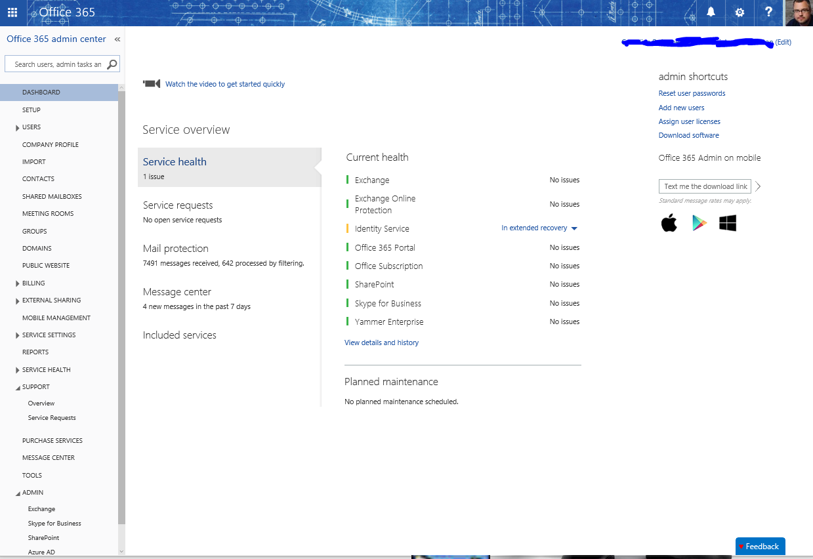
Microsoft Office 365 Admin Center
Notes:
Tada!

Slide 21
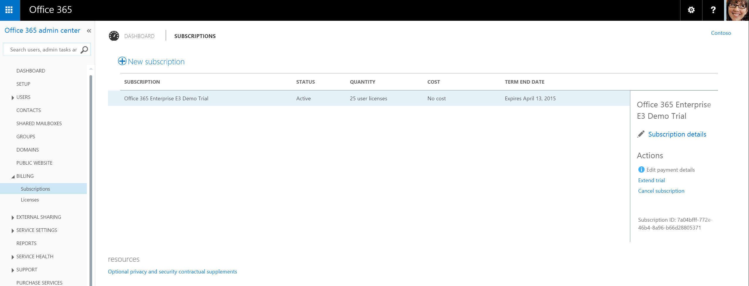
Billing and Subscription Management
Notes:
Note about license managmenet – If you have many users, unless you have lots of free time and don’t like to be awesome, you’ll need powershell. More on that from Thomas soon.

Slide 22
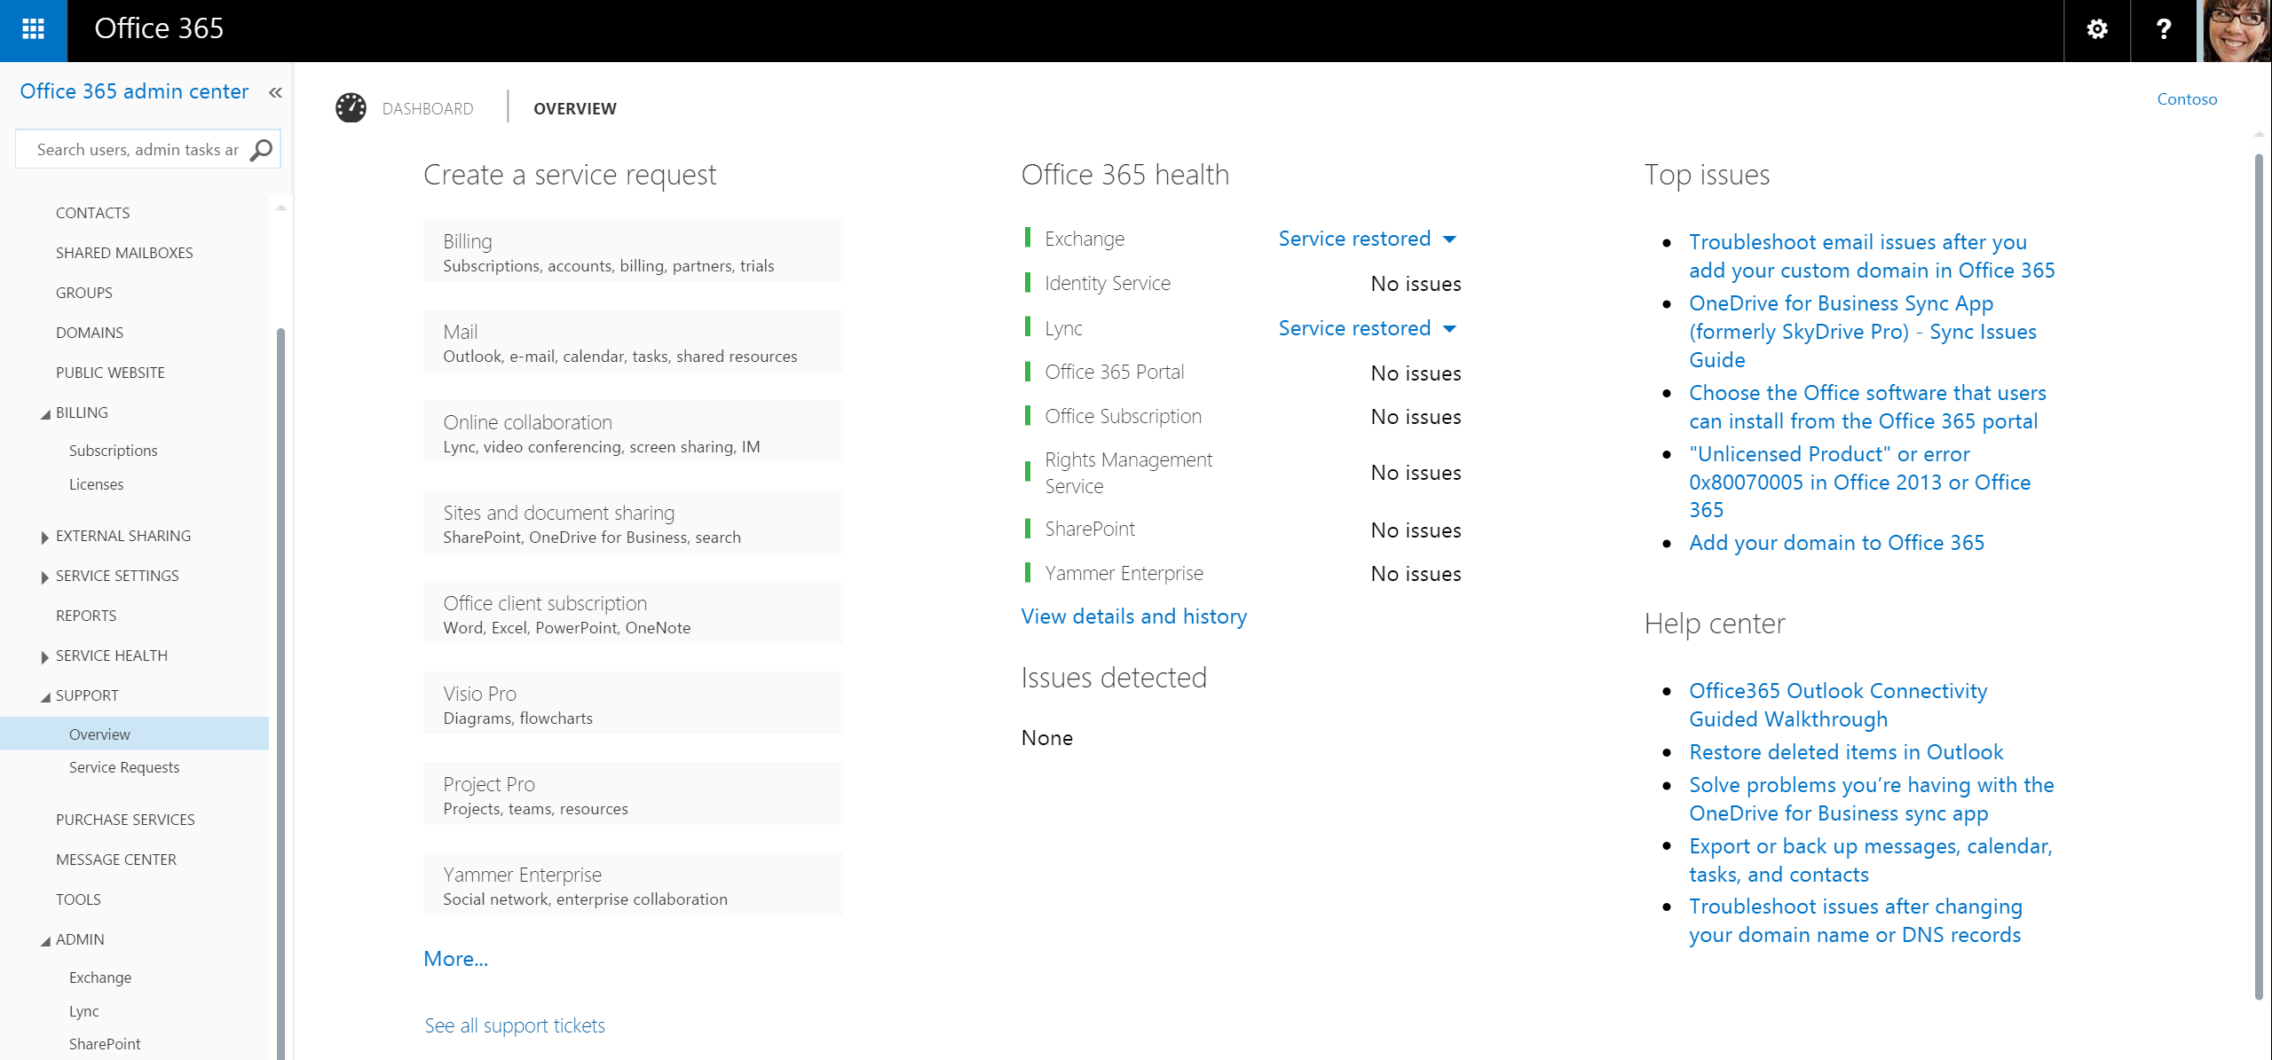
Support Management
Notes:
Very easy to use portal, Support has been good so far when I’ve used it.
Sometimes using Technet Forumns and asking a quesiotn is faster though, it’s also likely your question has been answered

Slide 23
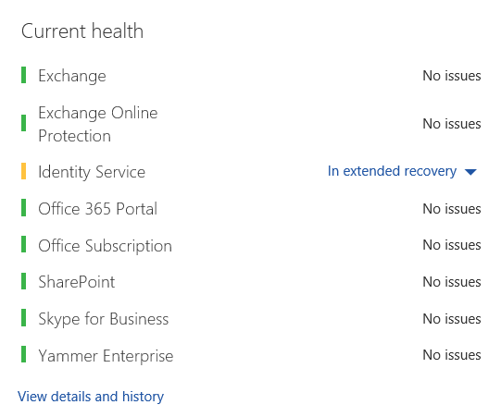
Service Health
Notes:
When checking the service, you can get more details on what’s going on , and what’s affected
This is a snap of one of the portals I manage this morning.

Slide 24
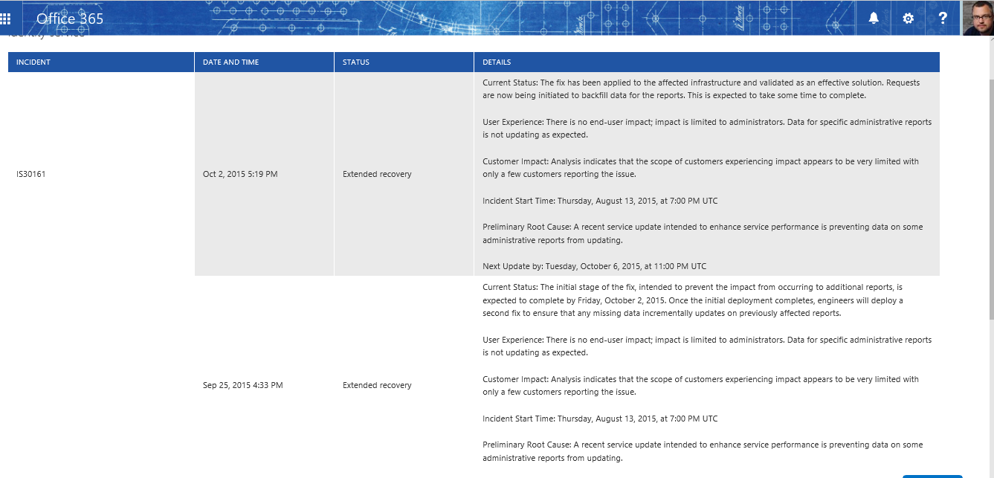
Notes:
Admins have experienced issues with reports on identify services since August 13th. Few customers reported. Fix has been applied, as of Oct 2nd it’s now in extended recovery.
Sometimes lists mitigation, which areas of the world are affected, etc.

Slide 25
Module 1: Office 365 Overview & Infrastructure
Service Overview & Offering
Features & Requirements
Office 365 Administration | Portals & PowerShell
Partner Opportunity

Slide 26
Module 1: Office 365 Overview & Infrastructure
Office 365 Administration | Portals & PowerShell

Slide 27
Hello PowerShell
PowerShell Scripting via a PowerShell Authentication performed through Online ID
Single credential can be used for Portals and PowerShell
PowerShell capabilities for Office 365 Administration
User and license management
Security Groups, Role-Based Access
More methods over time based on customer feedback
PowerShell scripting is available for all online services
Combine PowerShell scripts to automate workflows and task sequences
Notes:
Speaker Notes With Microsoft Windows PowerShell™, service administrators can perform many tasks using a script or automated process.
Example tasks that can be fully automated included:
creating users
resetting passwords
assigning licenses
obtaining service-use data
User renaming – you need to use powershell to get this task done if using AD Sync as you cannot change the attibutes inside the portal
Tom RANT about remote admin and how godlik it makes him feel.

Slide 28
Using Service Module for PowerShell
Windows Azure Active Directory Module for Windows PowerShell Requirements:
Operating system: Windows 7, Windows 8, Windows 8.1, Windows Server 2008 R2, Windows Server 2012 or Windows Server 2012 R2
Microsoft .NET Framework: You must install the Microsoft .NET Framework 3.51 feature
Install Updates: Ensure you have installed all of the required updates required by the Microsoft cloud services to which you have subscribed
Install Microsoft Online Services Sign-in Assistant: http://www.microsoft.com/en-us/download/details.aspx?id=41950
Install the Windows Azure AD Module for Windows PowerShell: http://aka.ms/aadposh
Common PowerShell Cmdlets are also listed at the above link

Slide 29
Common PowerShell Management Tasks
Create a new user “bobsmith@contoso.com”
New-MsolUser –UserPrincipalName bobsmith@contoso.com -DisplayName “Bob Smith” –FirstName “Bob” –LastName “Smith”
Set User Password
Set-MsolUserPassword
Assign mailbox permissions
Set-MailboxPermission
Change account password timeout settings
Set-MsolPasswordPolicy

Slide 30
Module 1: Office 365 Overview & Infrastructure
Service Overview & Offering
Features & Requirements
Office 365 Administration | Portals & PowerShell
Partner Opportunity

Slide 31
Module 1: Office 365 Overview & Infrastructure
Partner Opportunity
Notes:
Henry

Slide 32
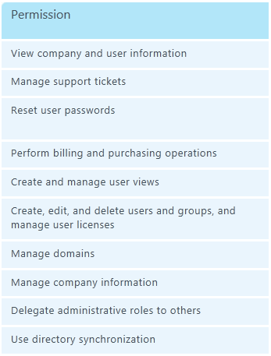
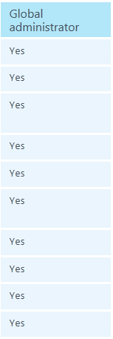
Partner-Delegated Administrators
Being named as a Delegated Administrator allows:
View all of your customers in one place
Perform admin tasks on behalf of a customer
View your customers’ service health
Create, edit, and view your customers’ service requests
Create trial invitations, purchase offers, and delegated admin requests
for Microsoft Partners
Notes:
Partner account is granted Global Administrator role.
You can resell 365 to your customers

Slide 33
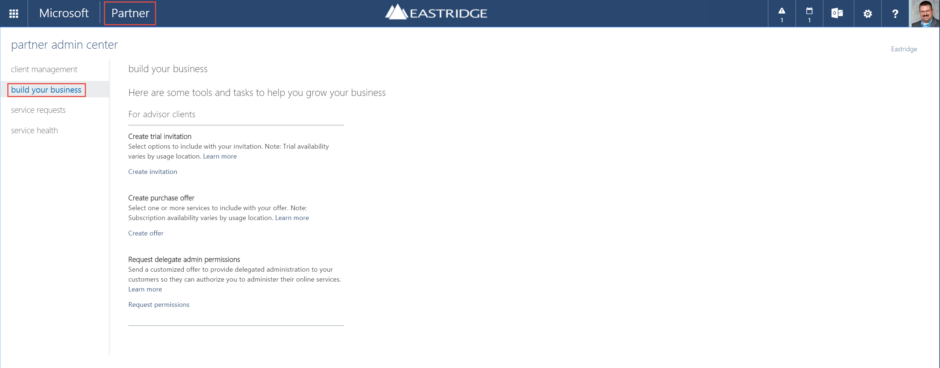
Office 365 Partner Admin Portal
for Microsoft Partners
Notes:
How you got here:
By successfully completing the sign-up process
What you should do here:
Explore the partner features of Microsoft Online Services, or click on Admin to start setting up Office 365 for your company to use.

Slide 34
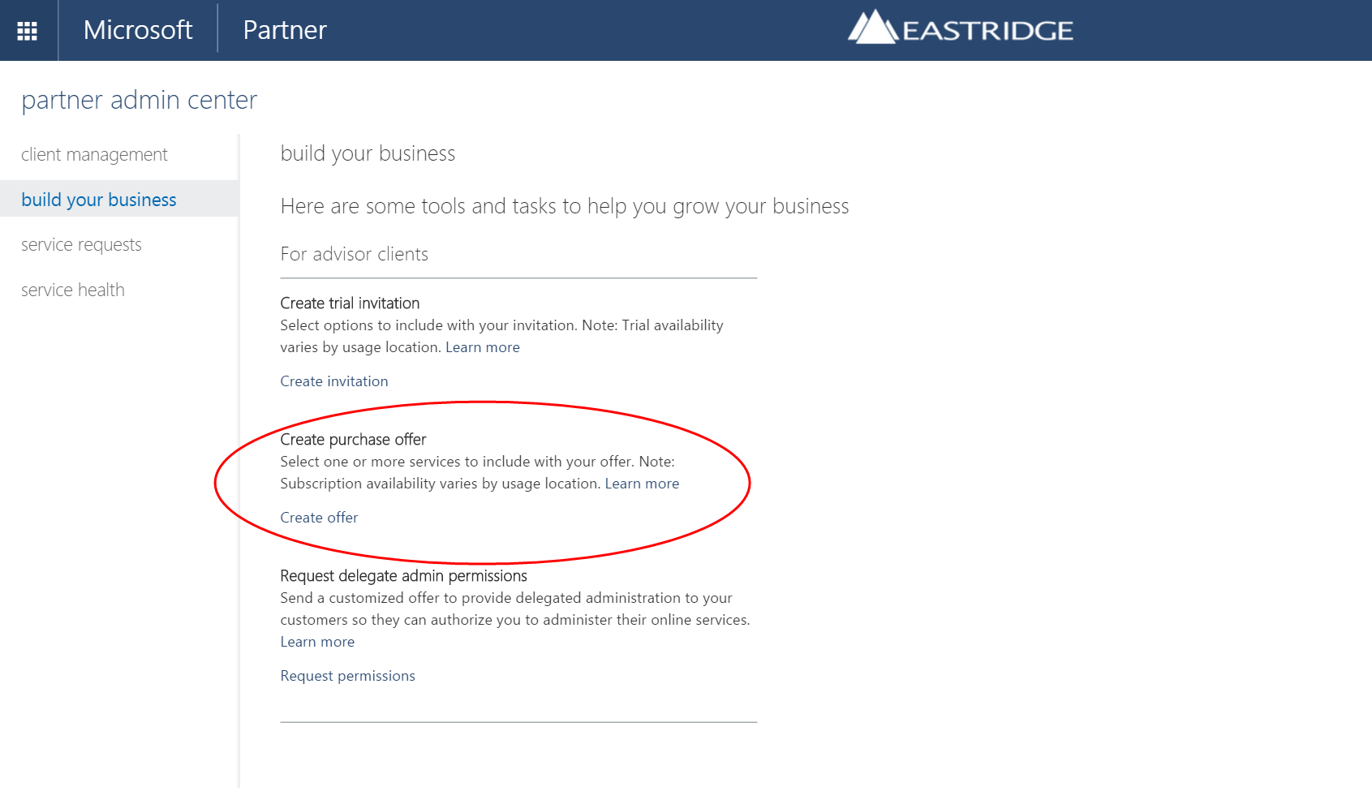
Create Purchase Offers
for Microsoft Partners
Notes:
Partners will log in to their Microsoft Online Portal for access to the partner capabilities: Purchase Offers, Trial Invitations, and Delegated Administration. Once logged in, they will click on the Partner link at the top to arrive at this page.

Slide 35
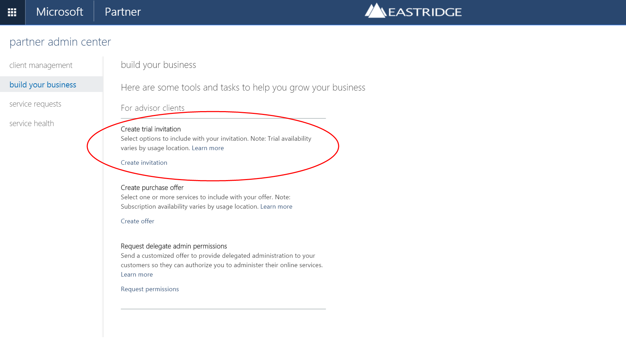
Send Trial Invitations
for Microsoft Partners
Notes:
Want to show your client what it can do? Set it up and have your company name all over the offering. Set it up that you have delegated administration!

Slide 36
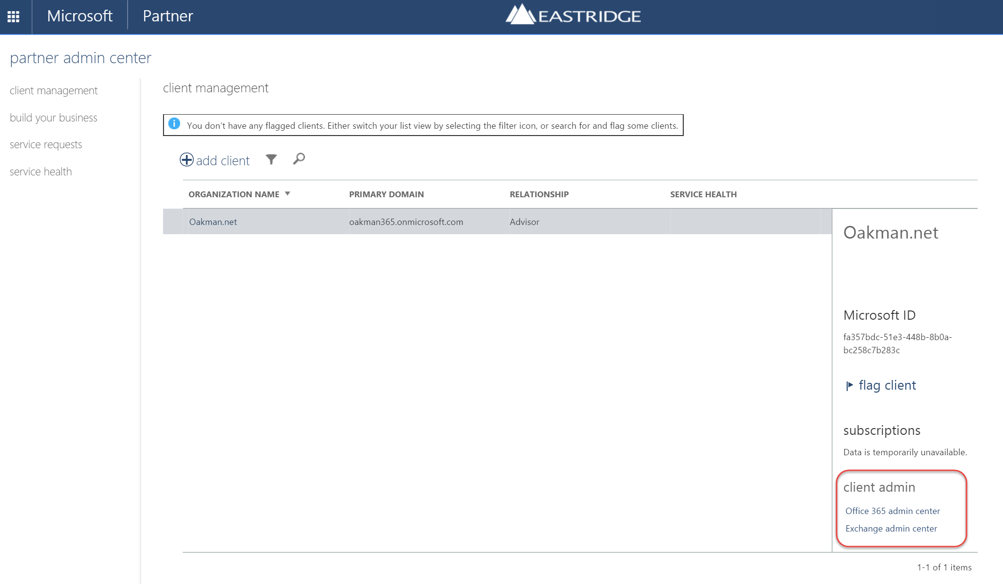
Administer on Behalf of…
for Microsoft Partners
Notes:
You can also ask for delegate admin for an exsisting customer. You simply find the customer in the portal, and it send them an email with your information. This allows you to support and drive value for your services.

Slide 37
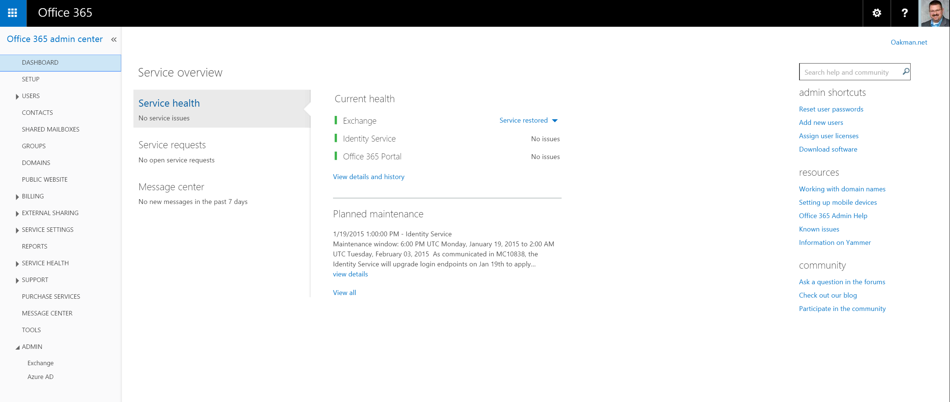
Perform Admin Tasks
for Microsoft Partners
Notes:
Once a client gives you access, you see the same page as if it was your own tenant
Clients can also easily accss delegated admins and remove you, something that you can explain early on, they still have control of their data much like they have keys for their building.

Slide 38
Resources
Office 365
http://office.microsoft.com/en-us/
Office 365 Enterprise Service Descriptions
http://technet.microsoft.com/en-us/library/jj819284.aspx
Office 365 Data Sheets
http://office.microsoft.com/en-us/compare-office-365-for-business-plans-FX102918419.aspx?WT%2Emc%5Fid=PS%5Fbing%5FO365Comm%5Fwhat%20is%20office%20365%5FText&WT%2Eintid1=ODC%5FENUS%5FFX102918418%5FXT104063440
Partner Delegate Administration
http://onlinehelp.microsoft.com/en-us/office365-partner01/gg243437.aspx
Community
Technet
Social Media (Twitter, Blogging)
EMUG – www.emug.ca

